Slide 1

JBIG
SEMINAR
3팀

Slide 2
JBIG
CONTENTS
SEMINAR
01. Activation Function
02. Data Preprocessing
03. Weight Intialization
04. Batch Normalization
05. Transfer learning

Slide 3
01
Sigmoid
SEMINAR
Fig. 1.

Slide 4
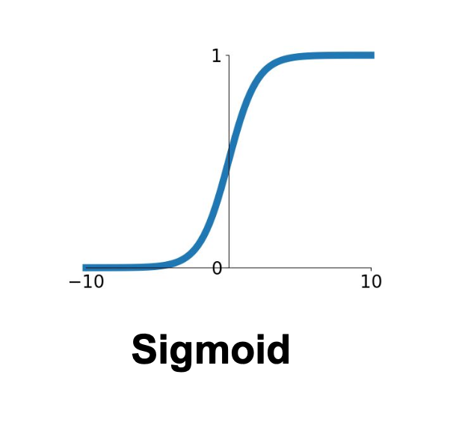
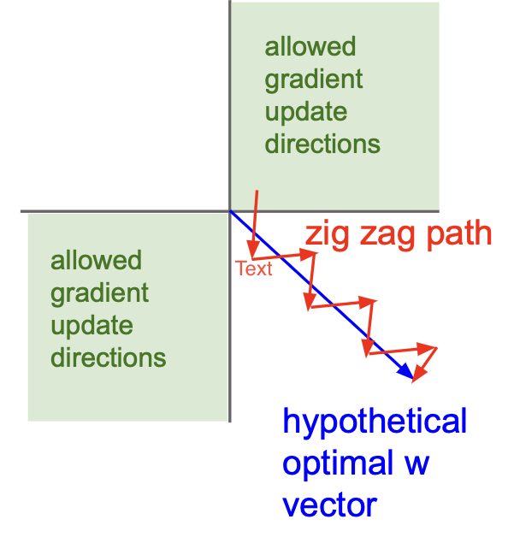
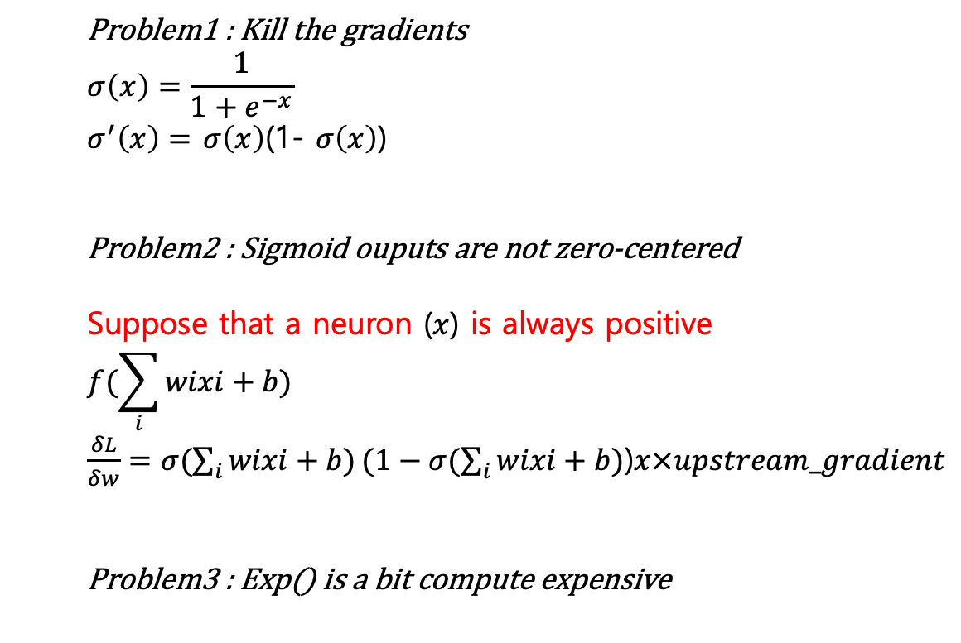
01
Sigmoid
SEMINAR
Problem1 : Kill the gradients
$$σ\left(x\right)=\frac{1}{1+e^{−x}}$$
$σ^{′}\left(x\right)=$ $σ\left(x\right)$(1- $σ\left(x\right)$)
Problem2 : Sigmoid ouputs are not zero-centered
Suppose that a neuron ($x$) is always positive
$$f(\sum_{i}{wixi+b})$$
$\frac{δL}{δw}=σ(\sum_{i}{wixi+b)}(1−σ(\sum_{i}{wixi+b)}$)$x×upstream_gradient$
Problem3 : Exp() is a bit compute expensive
Fig. 2.
Fig. 3.

Slide 5
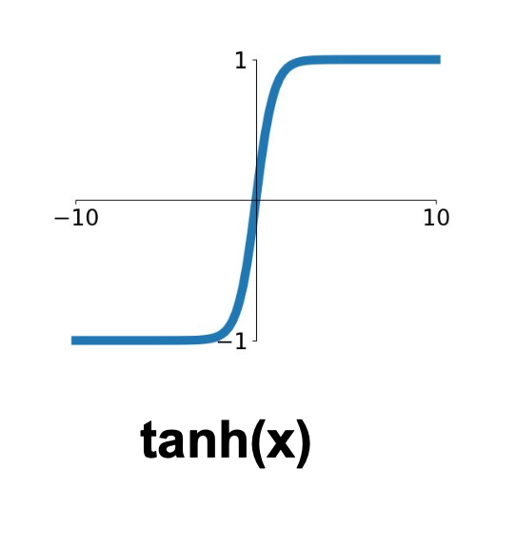
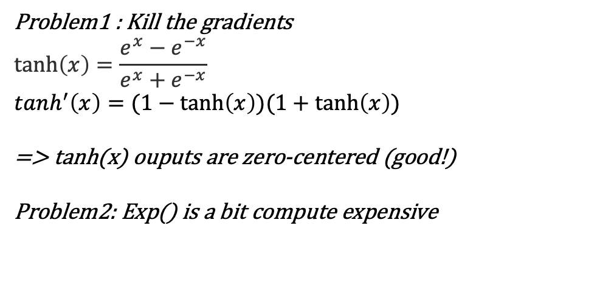
01
tanh
SEMINAR
Problem1 : Kill the gradients
$$\tanh\left(x\right)=\frac{e^{x}−e^{−x}}{e^{x}+e^{−x}}$$
$$tanh^{′}\left(x\right)=(1−\tanh\left(x\right))(1+\tanh\left(x\right))$$
=> tanh(x) ouputs are zero-centered (good!)
Problem2: Exp() is a bit compute expensive
Fig. 4.

Slide 6
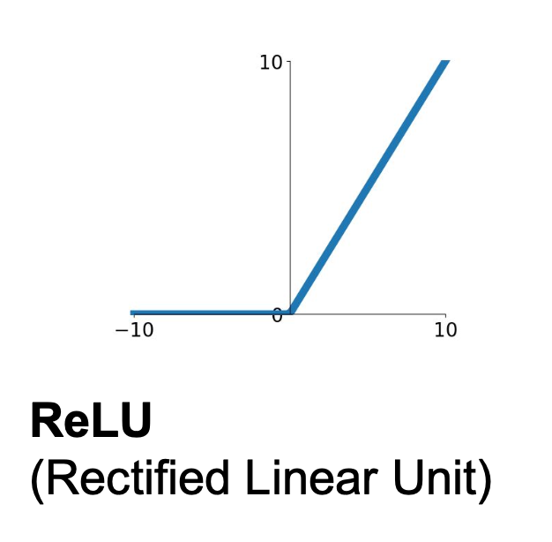
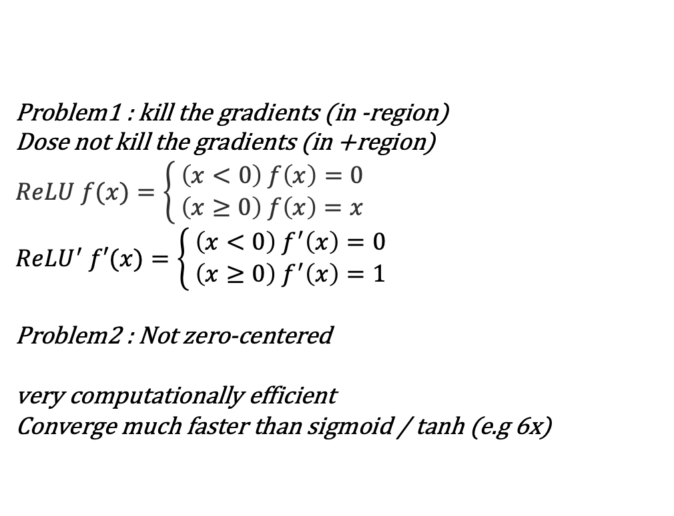
01
ReLU
SEMINAR
Problem1 : kill the gradients (in -region)
Dose not kill the gradients (in +region)
$$ReLU f(x)=\left\{\begin{aligned} \left(x<0\right) f\left(x\right)=0 \\ \left(x≥0\right) f\left(x\right)=x\end{aligned}\right.$$
$$ReLU^{′} f′(x)=\left\{\begin{aligned} \left(x<0\right){ f}^{′}\left(x\right)=0 \\ \left(x≥0\right) f^{′}\left(x\right)=1\end{aligned}\right.$$
Problem2 : Not zero-centered
very computationally efficient
Converge much faster than sigmoid / tanh (e.g 6x)
Fig. 5.
Fig. 6.

Slide 7
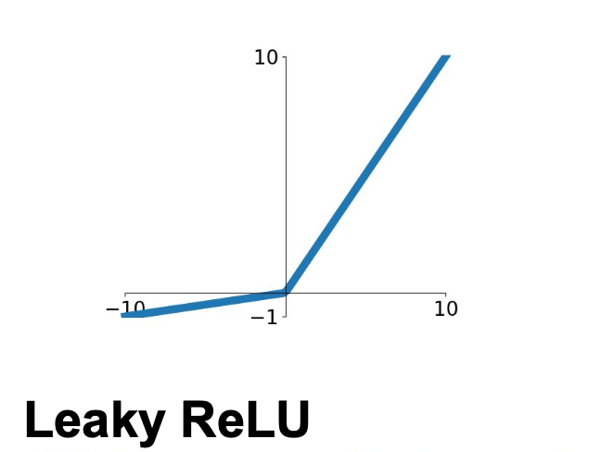
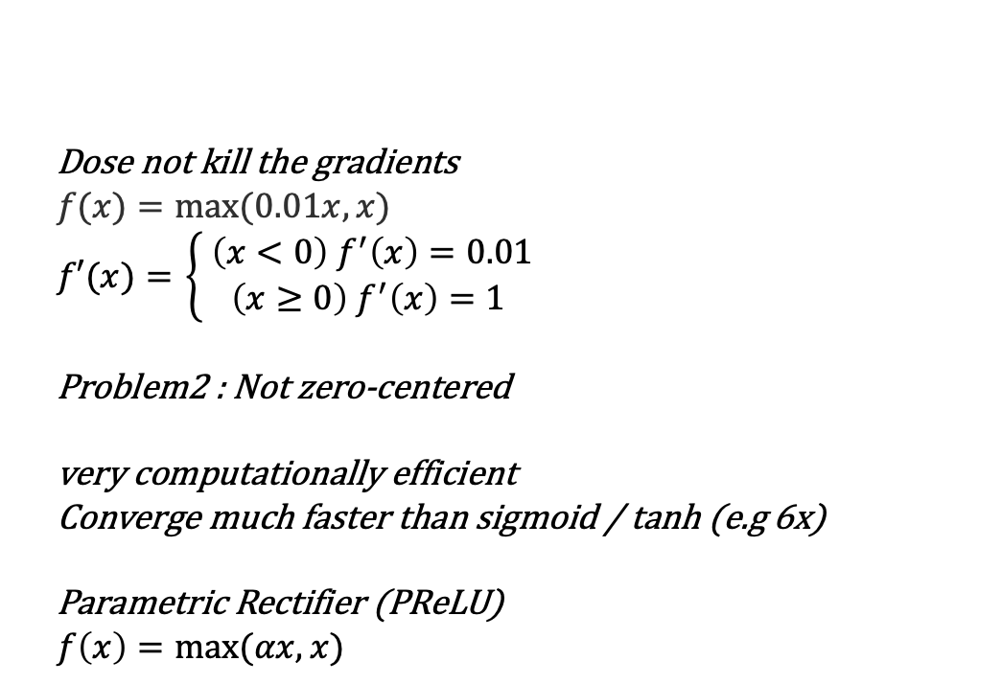
01
Leaky ReLU
SEMINAR
Dose not kill the gradients
$$f(x)=max⁡(0.01x, x)$$
$f′(x)=$ $\left\{\begin{aligned} \left(x<0\right){ f}^{′}\left(x\right)=0.01 \\ \left(x≥0\right) f^{′}\left(x\right)=1\end{aligned}\right.$
Problem2 : Not zero-centered
very computationally efficient
Converge much faster than sigmoid / tanh (e.g 6x)
Parametric Rectifier (PReLU)
$$f\left(x\right)=max⁡(αx,x)$$
Fig. 7.

Slide 8
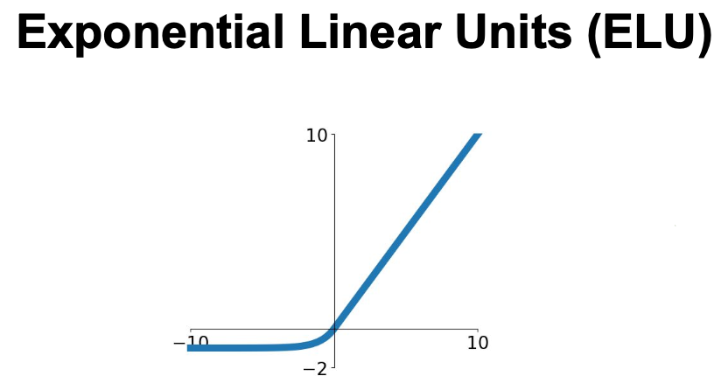
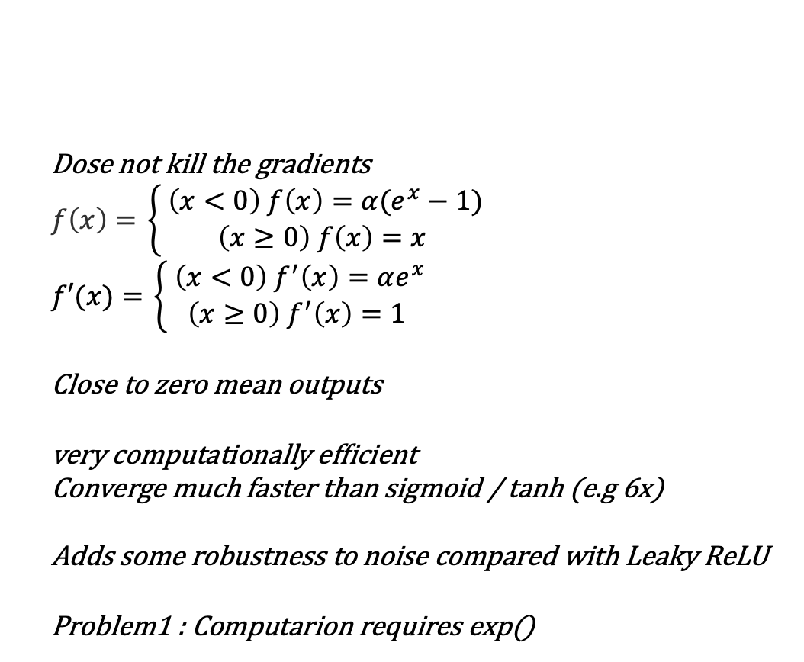
01
ELU
SEMINAR
Dose not kill the gradients
$f\left(x\right)=$ $\left\{\begin{aligned} \left(x<0\right) f\left(x\right)=α(e^{x}−1) \\ \left(x≥0\right) f\left(x\right)=x\end{aligned}\right.$
$f′(x)=$ $\left\{\begin{aligned} \left(x<0\right){ f}^{′}\left(x\right)=αe^{x} \\ \left(x≥0\right) f^{′}\left(x\right)=1\end{aligned}\right.$
Close to zero mean outputs
very computationally efficient
Converge much faster than sigmoid / tanh (e.g 6x)
Adds some robustness to noise compared with Leaky ReLU
Problem1 : Computarion requires exp()
Fig. 8.

Slide 9
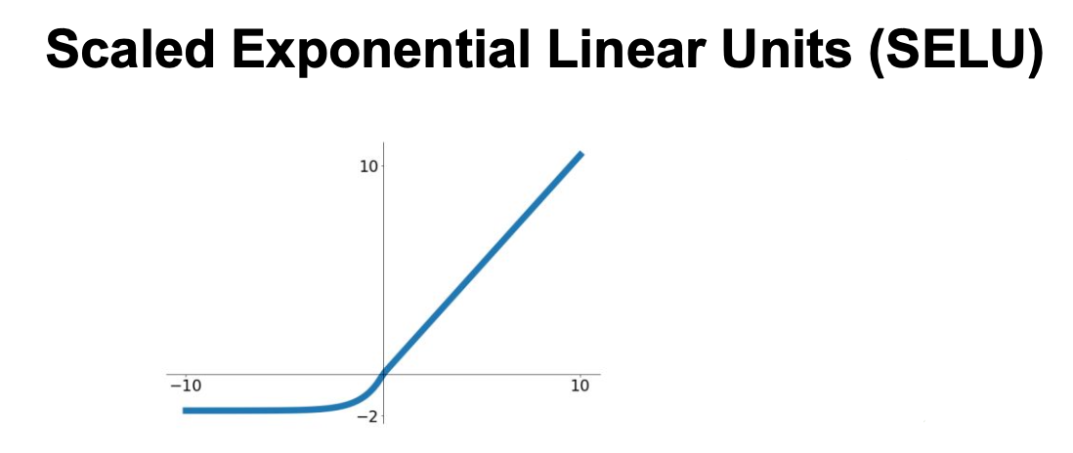
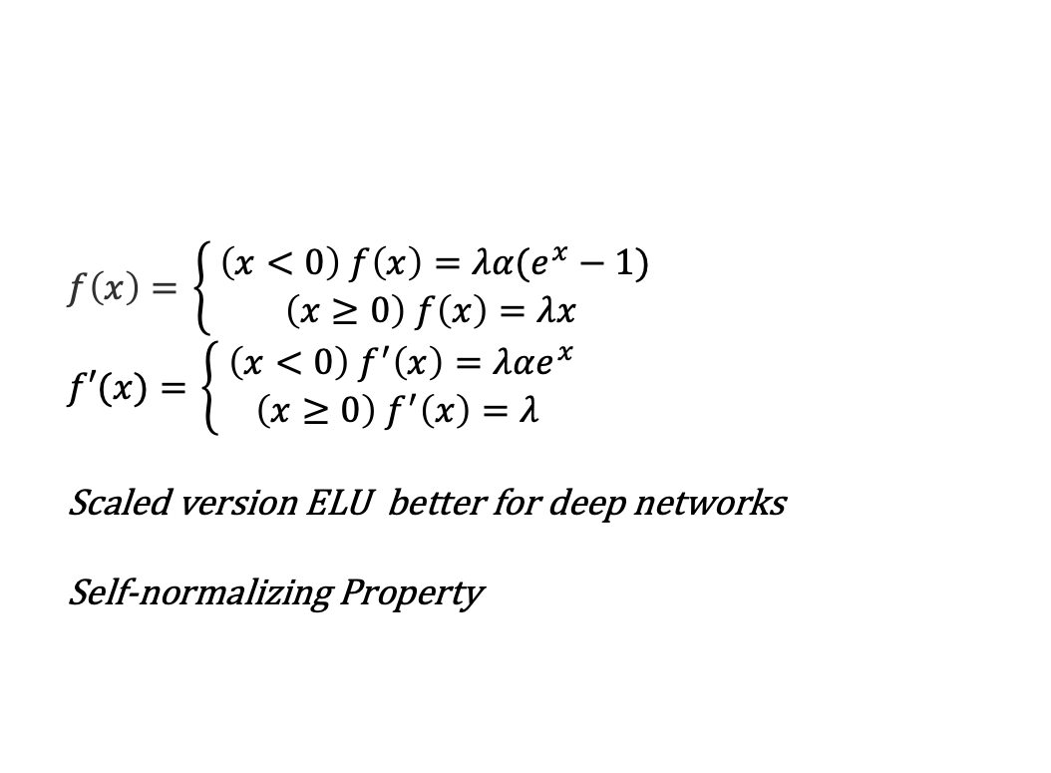
01
SELU
SEMINAR
$f\left(x\right)=$ $\left\{\begin{aligned} \left(x<0\right) f\left(x\right)=λα(e^{x}−1) \\ \left(x≥0\right) f\left(x\right)=λx\end{aligned}\right.$
$f′(x)=$ $\left\{\begin{aligned} \left(x<0\right){ f}^{′}\left(x\right)=λαe^{x} \\ \left(x≥0\right) f^{′}\left(x\right)=λ\end{aligned}\right.$
Scaled version ELU better for deep networks
Self-normalizing Property
Fig. 9.

Slide 10
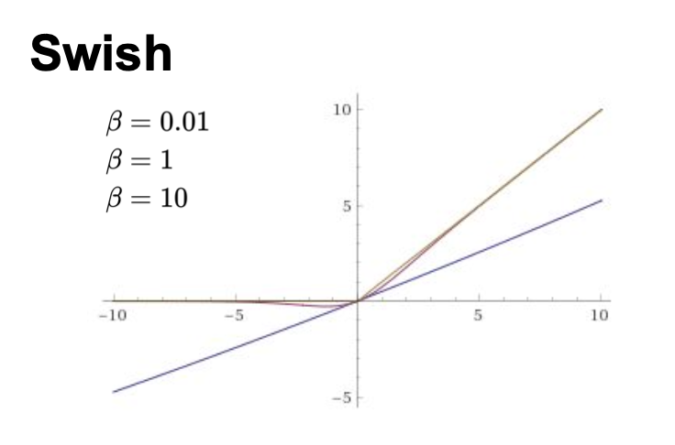
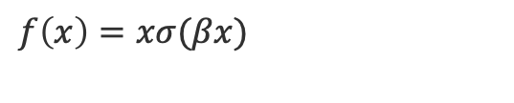
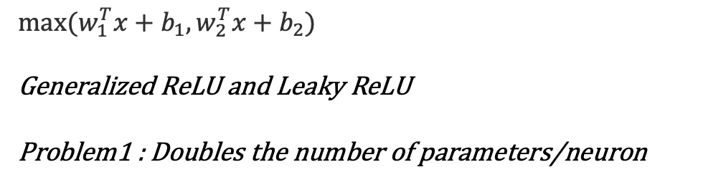
01
Maxout
SEMINAR
$$max⁡(w_{1}^{T}x+b_{1},w_{2}^{T}x+b_{2})$$
Generalized ReLU and Leaky ReLU
Problem1 : Doubles the number of parameters/neuron
Swish
$$f\left(x\right)=xσ(βx)$$
Fig. 10.

Slide 11
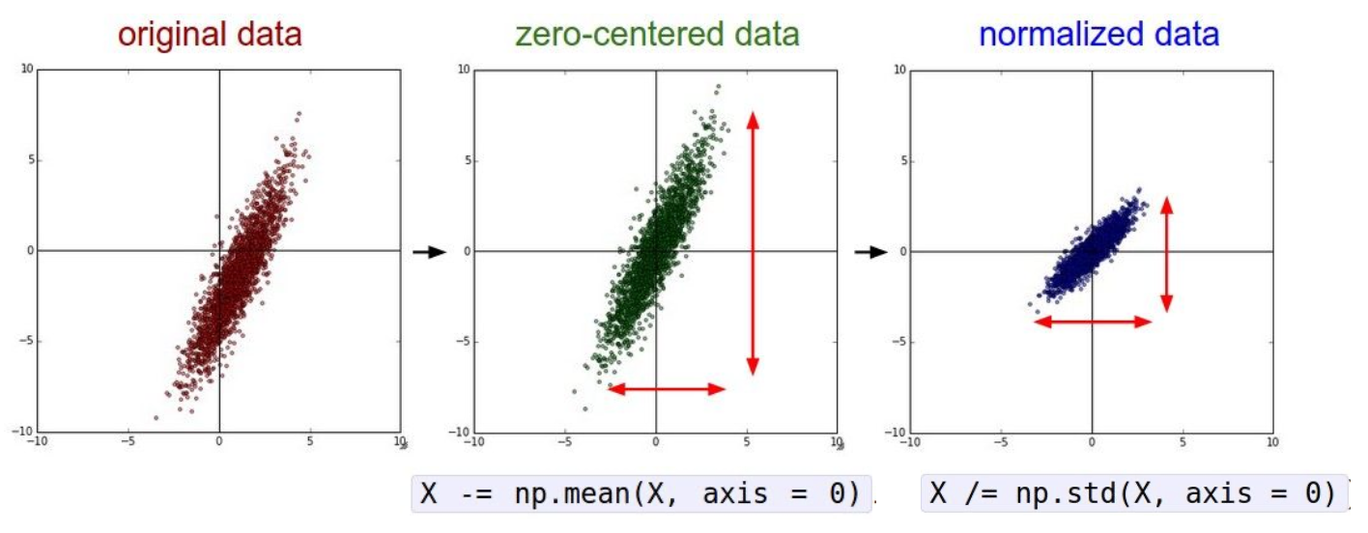
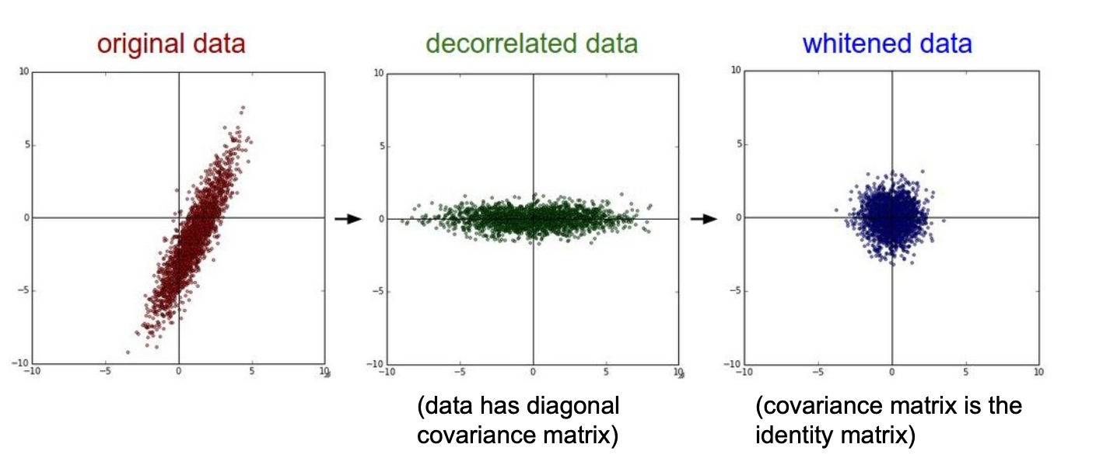
02
Data Preprocessing
SEMINAR
Fig. 11.

Slide 12
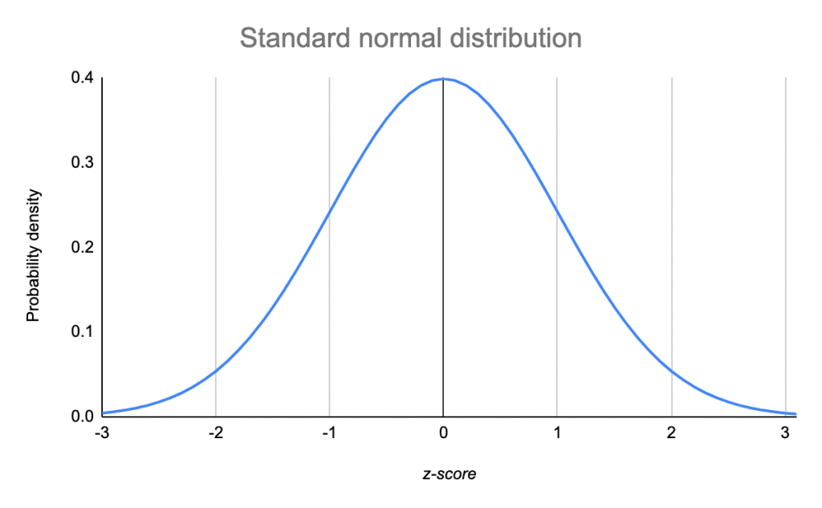
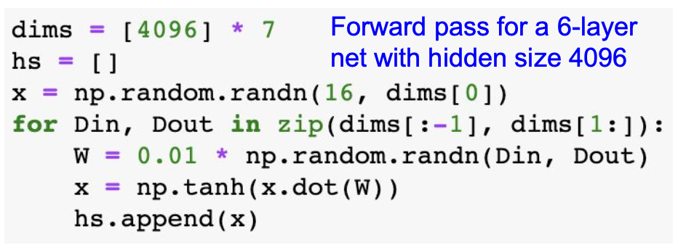
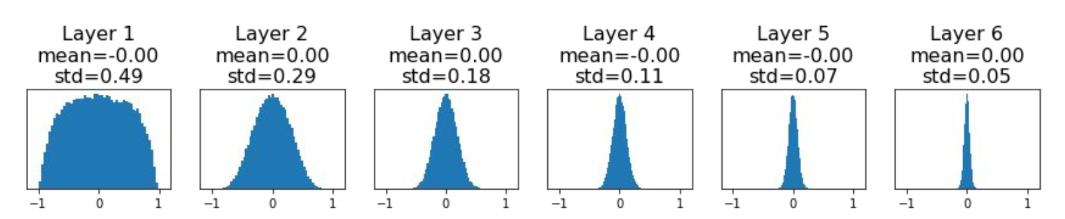
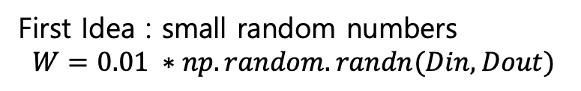
03
Weight Initialization
SEMINAR
First Idea : small random numbers
$$W=0.01 ∗np.random.randn(Din, Dout)$$
Fig. 11.
=> Standard normal distribution
If Model gets deeper?
Fig. 12.

Slide 13
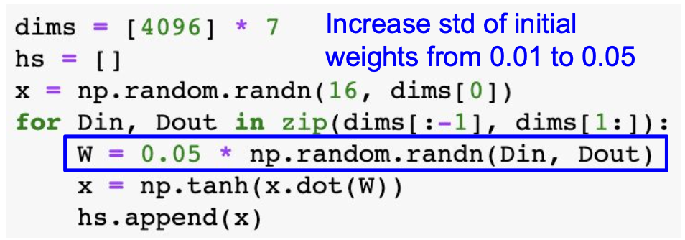
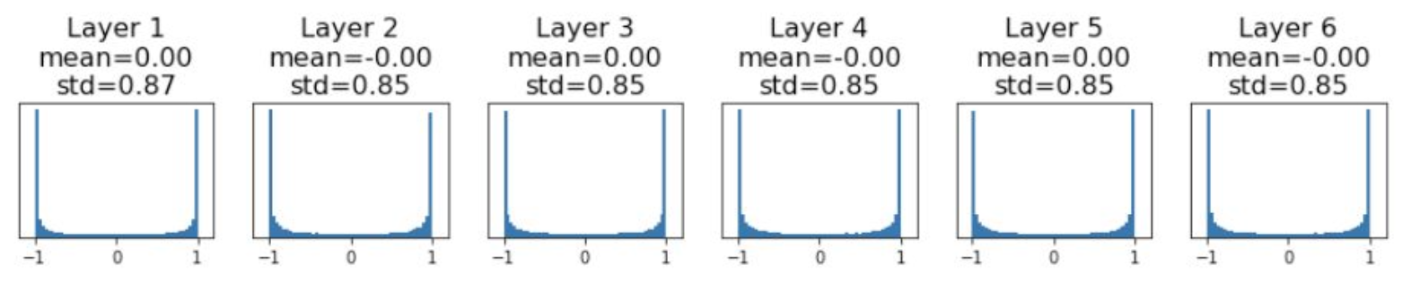
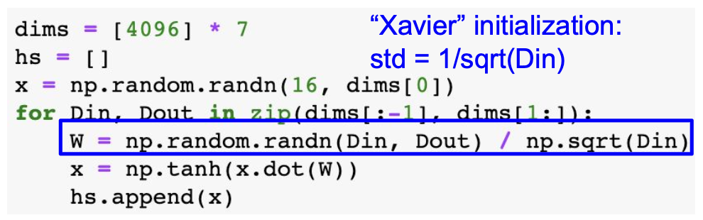
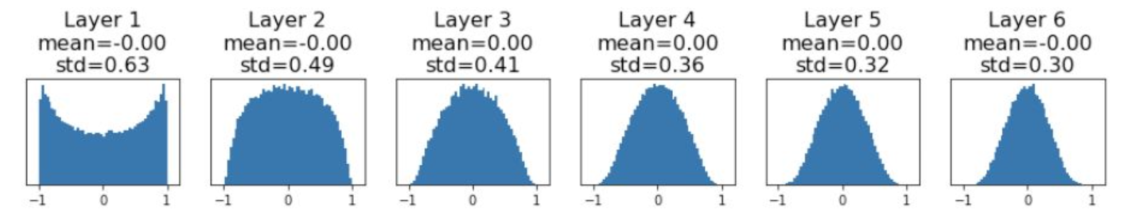
03
Weight Initialization
SEMINAR
Increase initial weights!
Fig. 13.
Xavier Initializtion
Fig. 14.

Slide 14
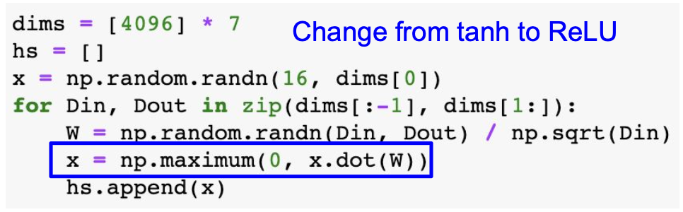
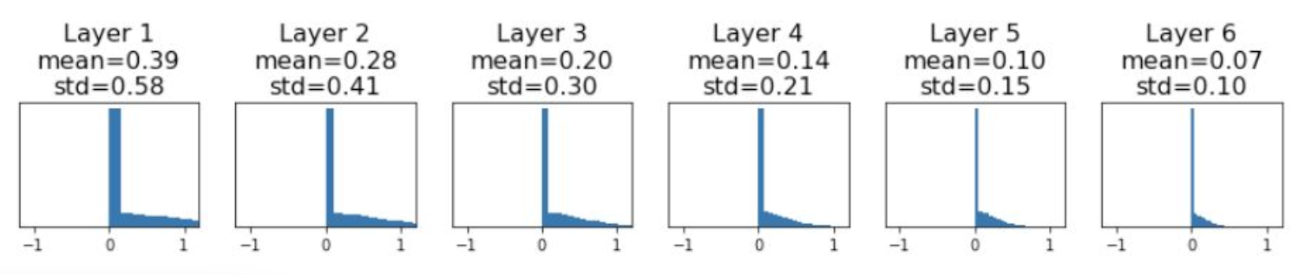
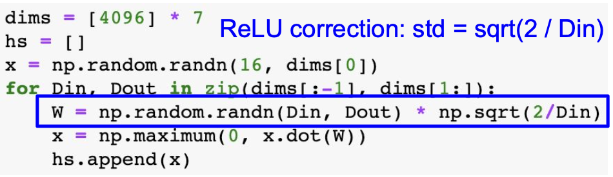
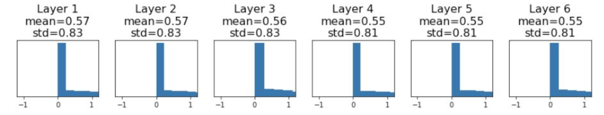
03
Weight Initialization
SEMINAR
How about ReLU?
Fig. 15.
Kaiming / MSRA Initializtion
Fig. 16.

Slide 15
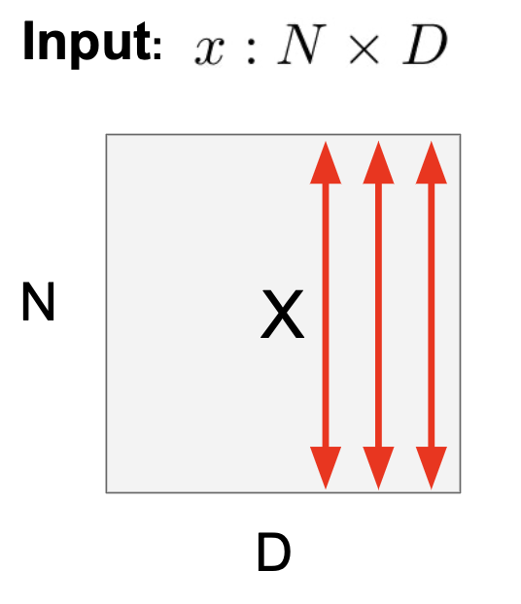
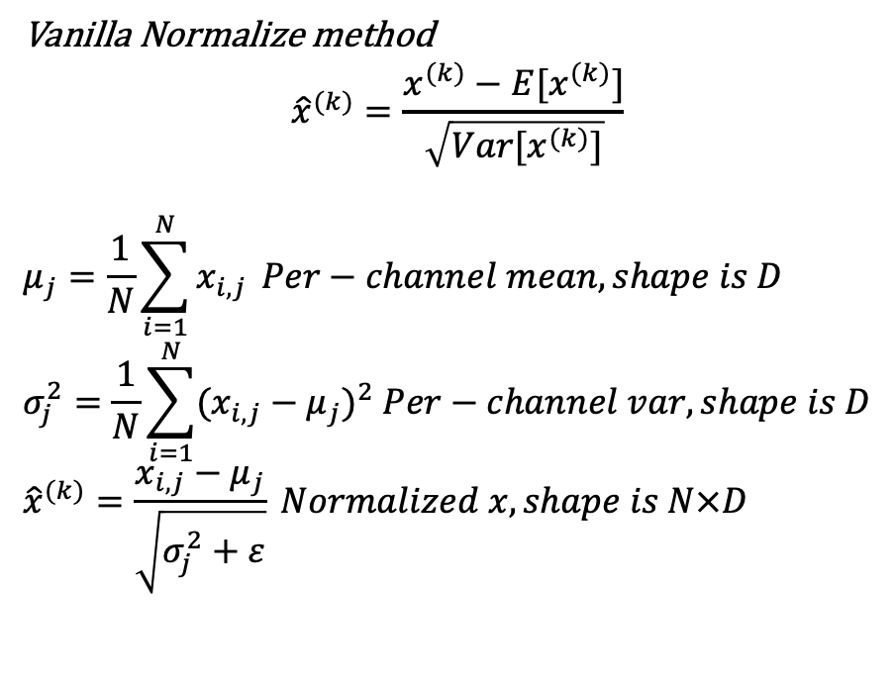
04
Batch Normalization
SEMINAR
Vanilla Normalize method
$${\hat{x}}^{(k)}=\frac{x^{(k)}−E[x^{(k)}]}{\sqrt{Var[x^{(k)}]}}$$
$$μ_{j}=\frac{1}{N}\sum_{i=1}^{N}{x_{i,j}} Per−channel mean,shape is D$$
$$σ_{j}^{2}=\frac{1}{N}\sum_{i=1}^{N}{{(x_{i,j}−μ_{j})}^{2} Per−channel var, shape is D}$$
$${\hat{x}}^{(k)}=\frac{x_{i,j}−μ_{j}}{\sqrt{σ_{j}^{2}+ε}} Normalized x, shape is N×D$$
Fig. 17.

Slide 16
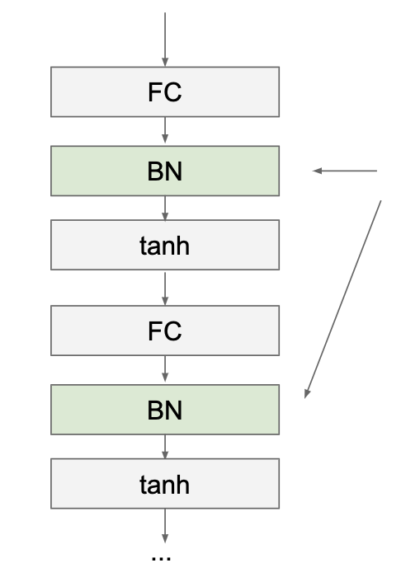
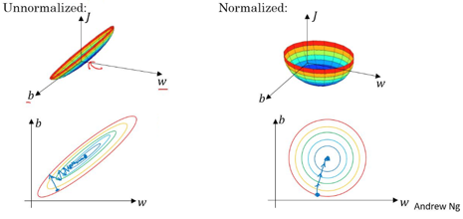
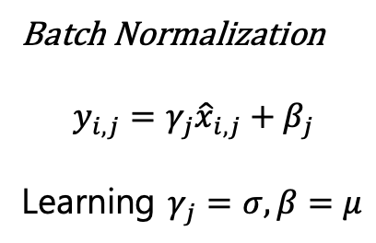
04
Batch Normalization
SEMINAR
Batch Normalization
$$y_{i,j}=γ_{j}{\hat{x}}_{i,j}+β_{j}$$
Learning $γ_{j}=σ, β=μ$
Usually inserted after FC or Conv layers,
and before nonlinearity
Make deep networks easier to train
Allow higer learning rates, faster convergence
More robust to initialization
Zero overhead at test-time
Improves gradient flow
Fig. 18.

Slide 17
05
Transfer learning
SEMINAR

Slide 18
05
Transfer learning
SEMINAR

Slide 19
05
Transfer learning
SEMINAR

Slide 20
05
Transfer learning
SEMINAR

